Slide 1
Airline Revenue and Safety
Airline Revenues Continue to Grow
Airline Fatalities/Incidents Lower than Auto
Airline Fatalities Decreased Over Last Two Decades
Air Travel Has Become Much Safer Since 2001
Airlines With Most Fatalities Not Domestic

Slide 2
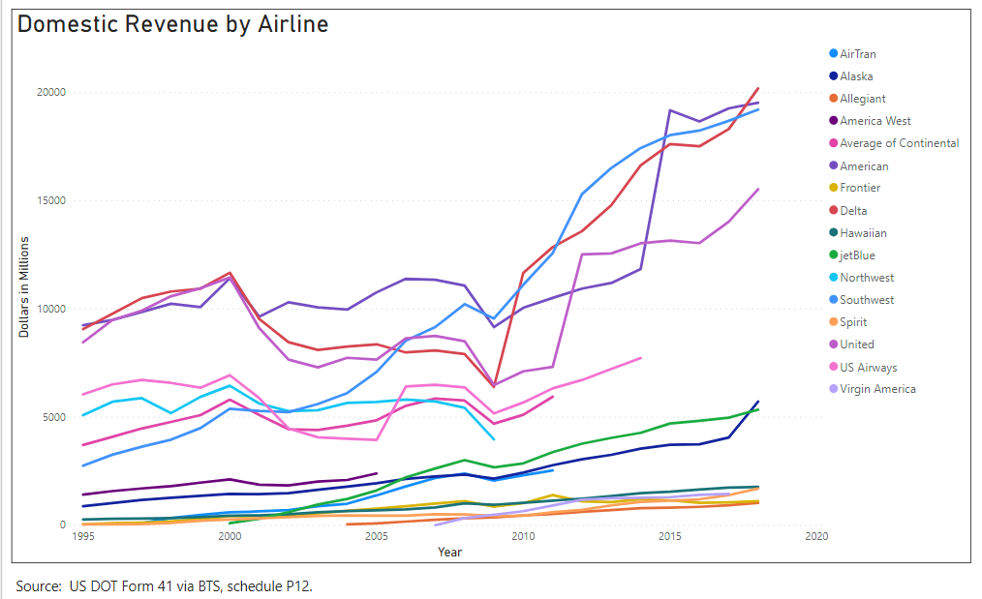
Domestic Airline Revenues Continue to Grow

Slide 3
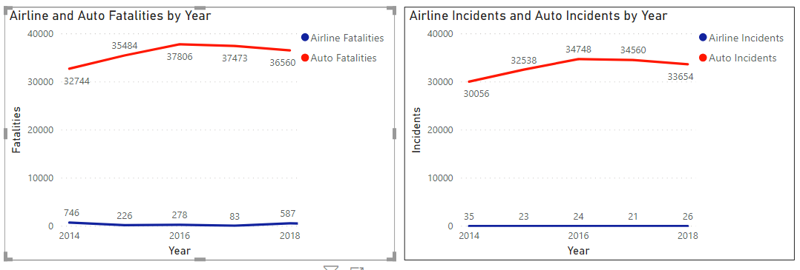
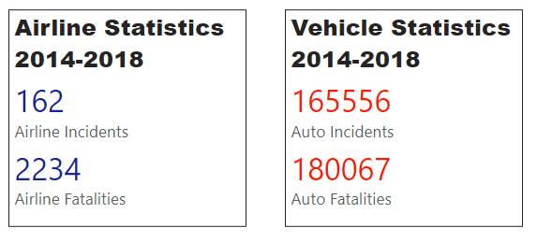
Airline Fatalities/Incidents Lower than Auto

Slide 4
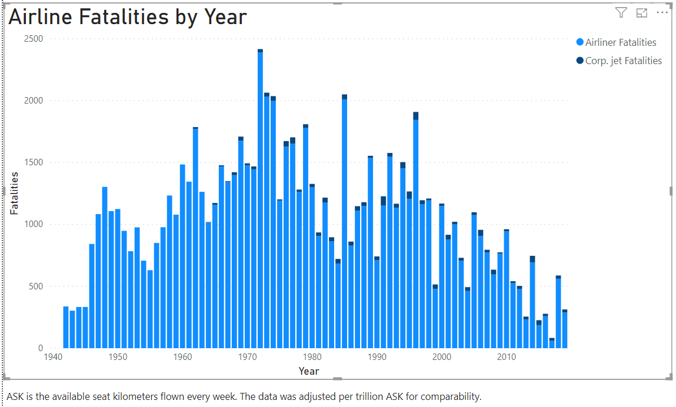
Airline Fatalities Decreased Over Last Two Decades

Slide 5
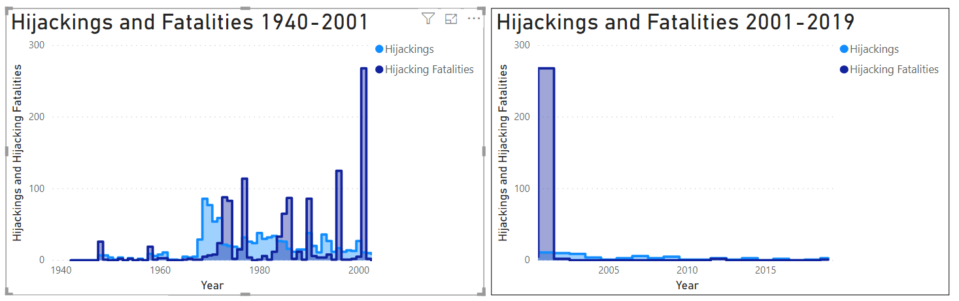
Air Travel Has Become Much Safer Since 2001

Slide 6
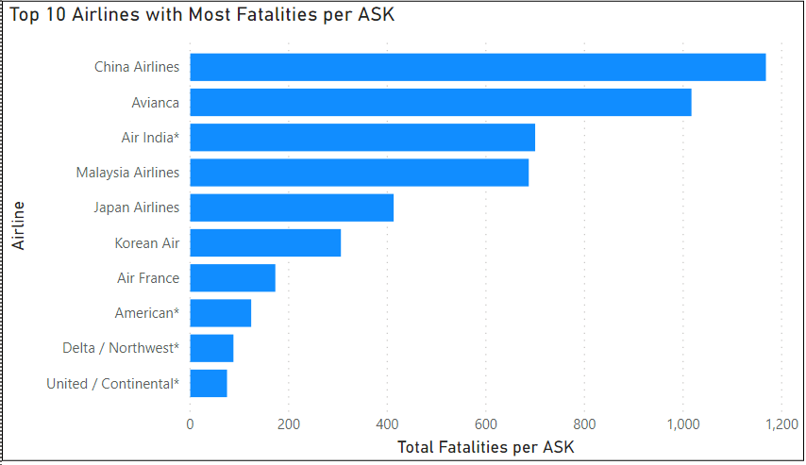
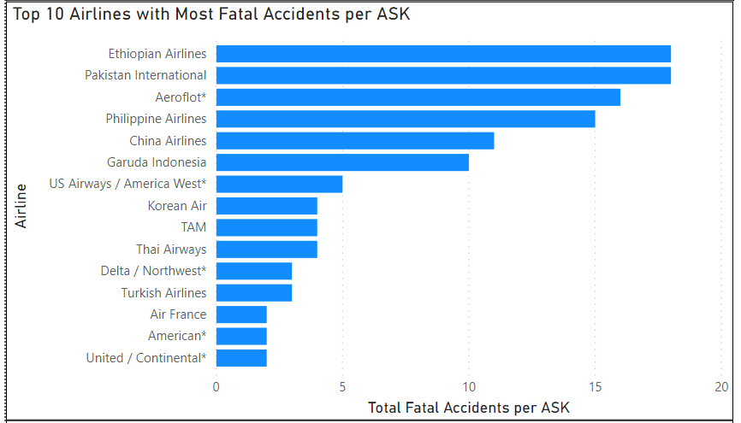
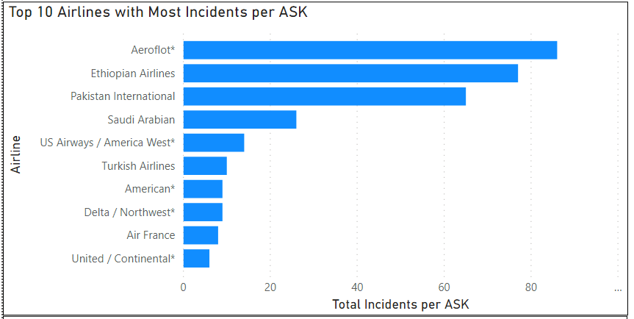
Airlines With Most Fatalities Not Domestic

